Slide 1
Finetune embedding models locally
Without asking your IT Department

Slide 2
What we’ll talk about
01
02
03
04
Introduction
Theory
Local limitations
Tools
05
Conclusion & alternative approaches

Slide 3

Dilovan Celik
Data Engineer/Analyst since 2014
Husband since 2018
Freelance since 2020
Dad since 2022

Slide 4
01
Introduction

Slide 5
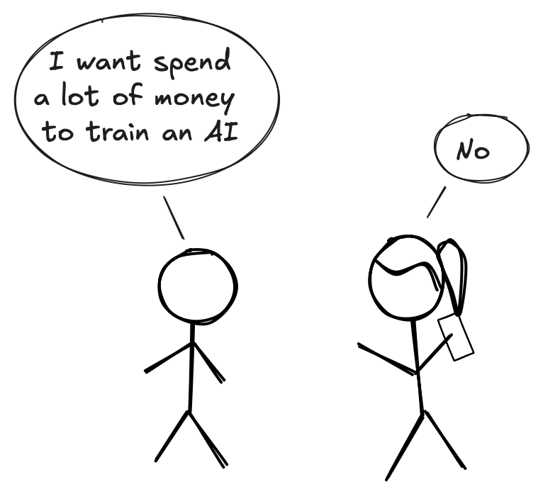
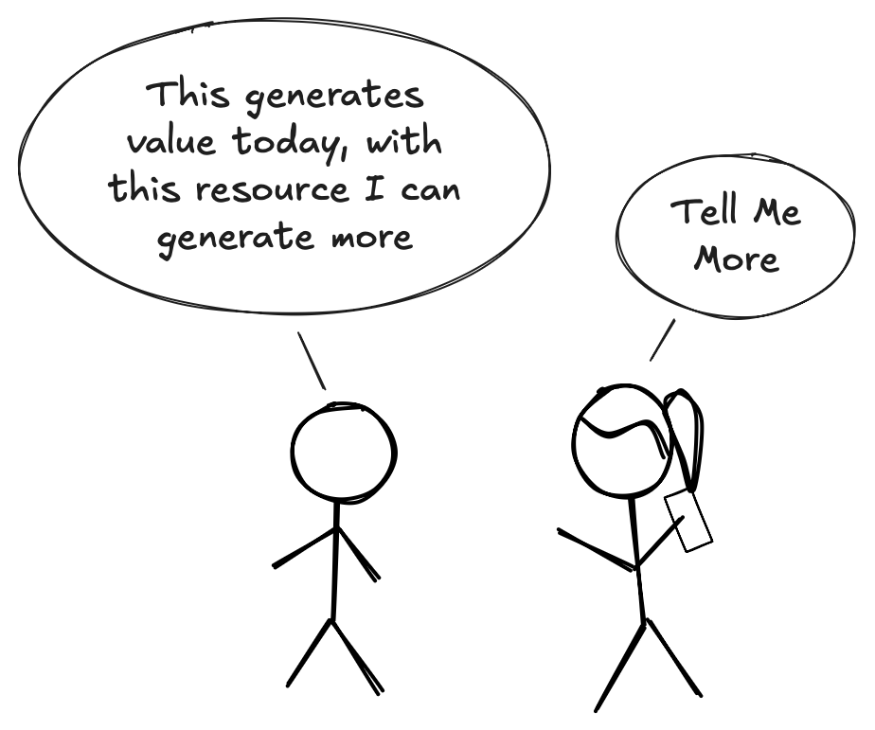
Why this matters

Slide 6
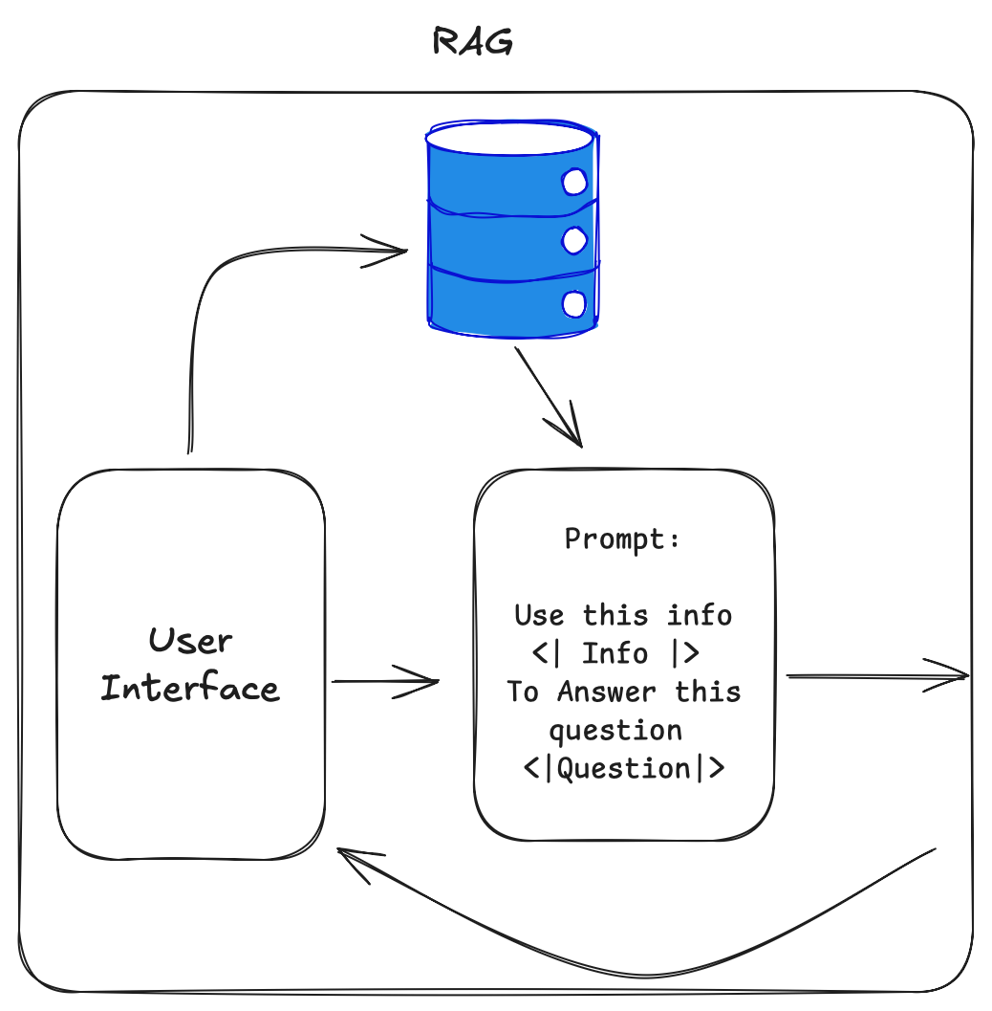
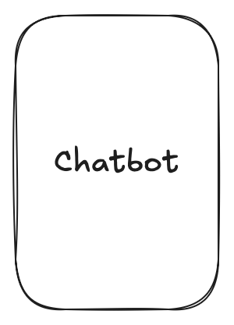
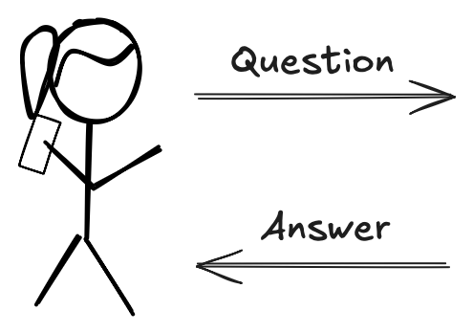
Retrieval Augmented Generation (RAG)

Slide 7
02
Theory

Slide 8
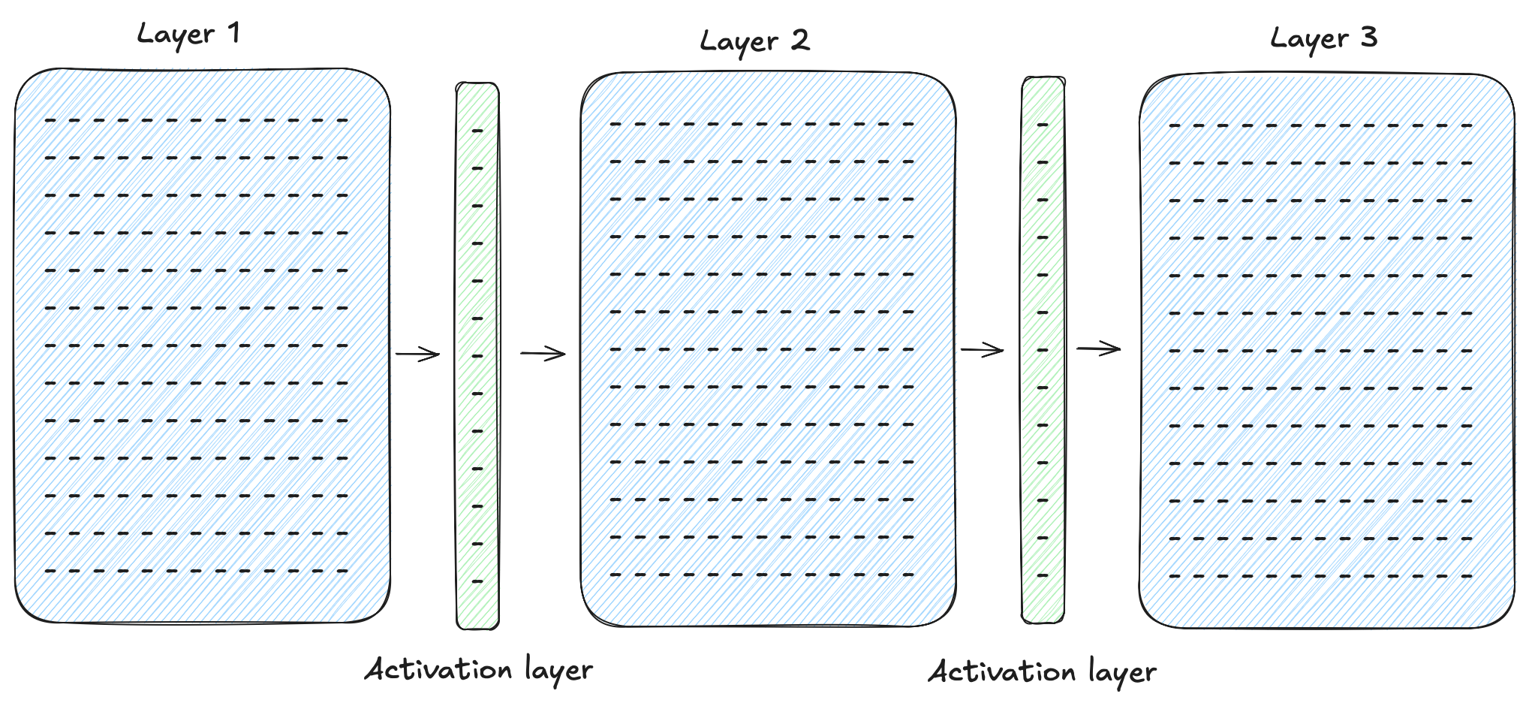
What’s a model?

Slide 9
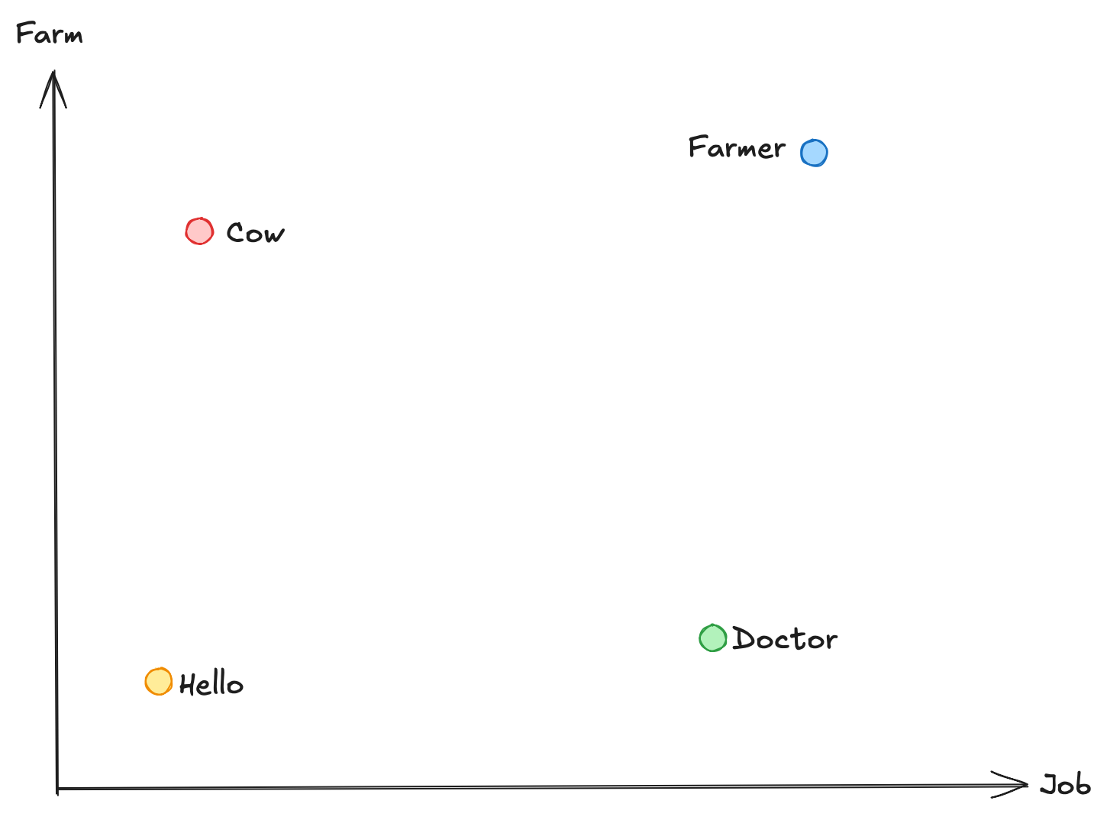
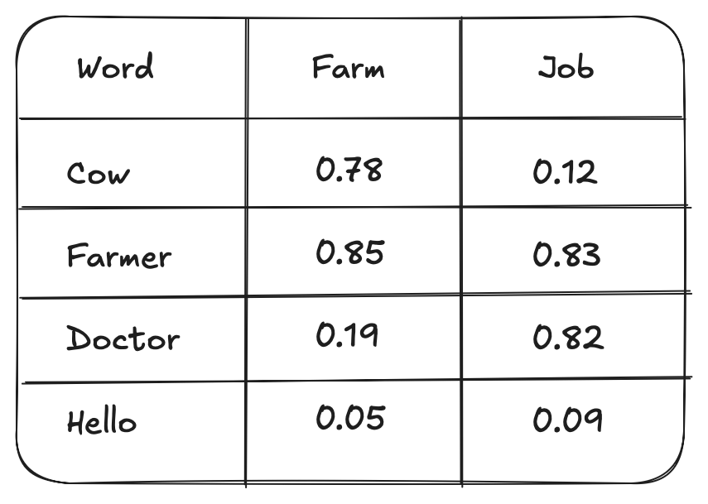
Embedding

Slide 10
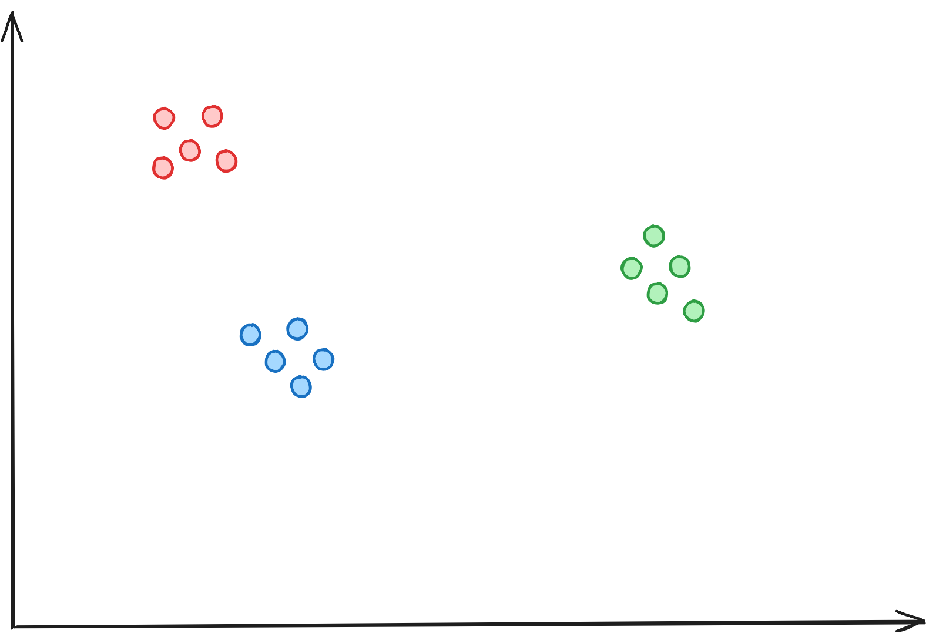

Embedding retrieval

Slide 11
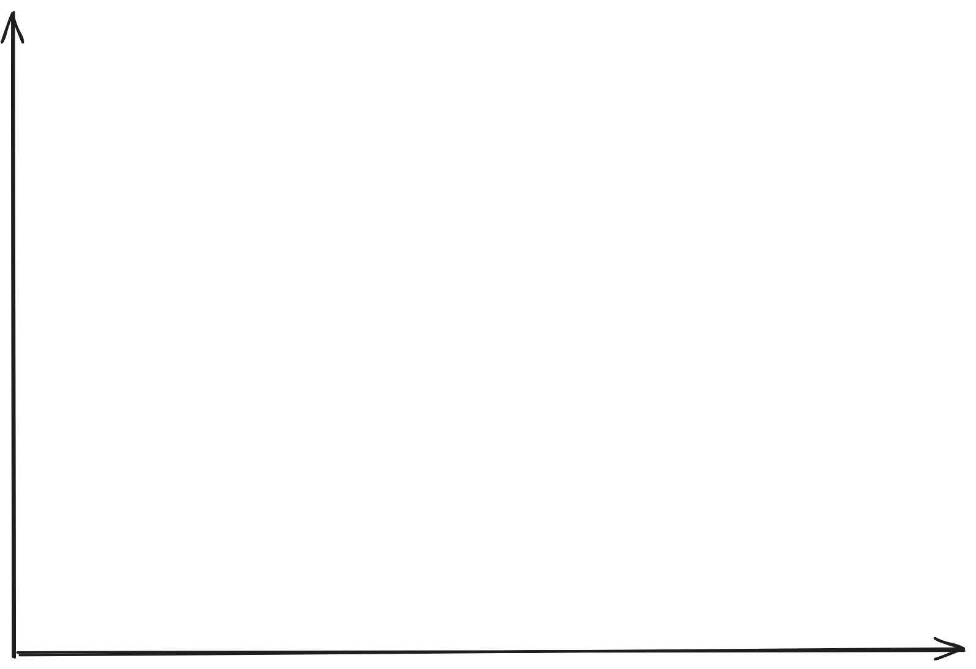
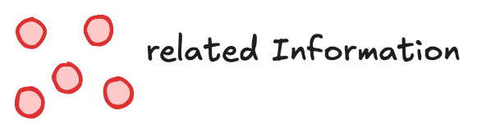
Finetuning objective

Slide 12
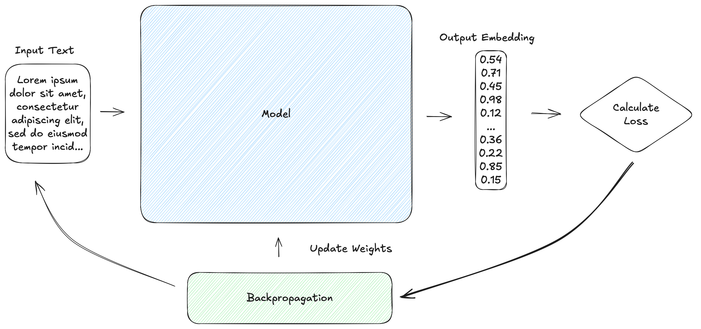
How do we train it?

Slide 13
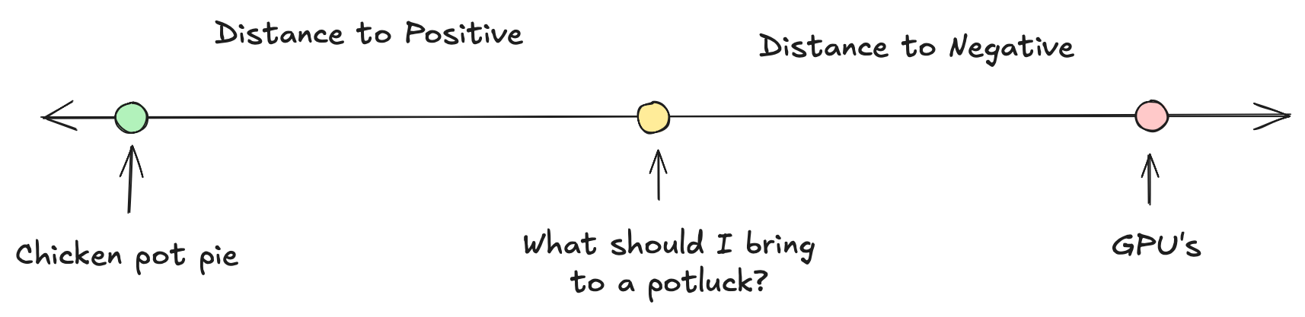
Triplet Loss

Slide 14
03
Local Limitations

Slide 15

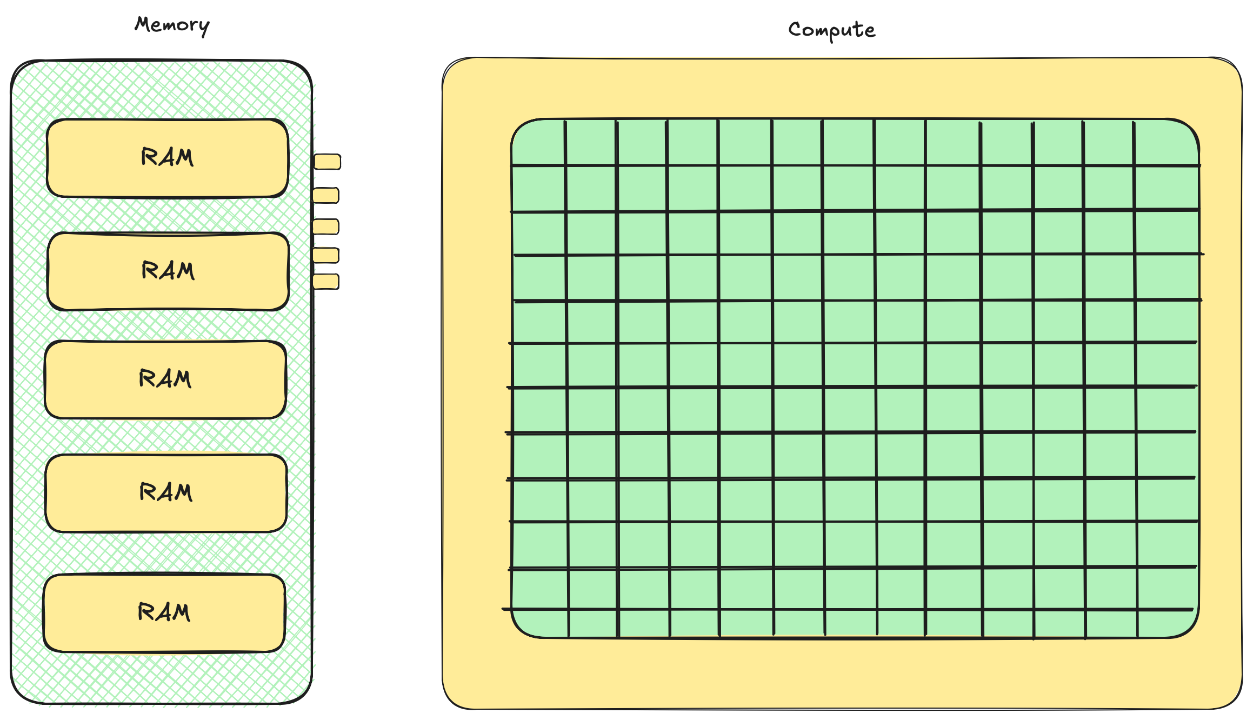
Limitations
Data
Hardware

Slide 16
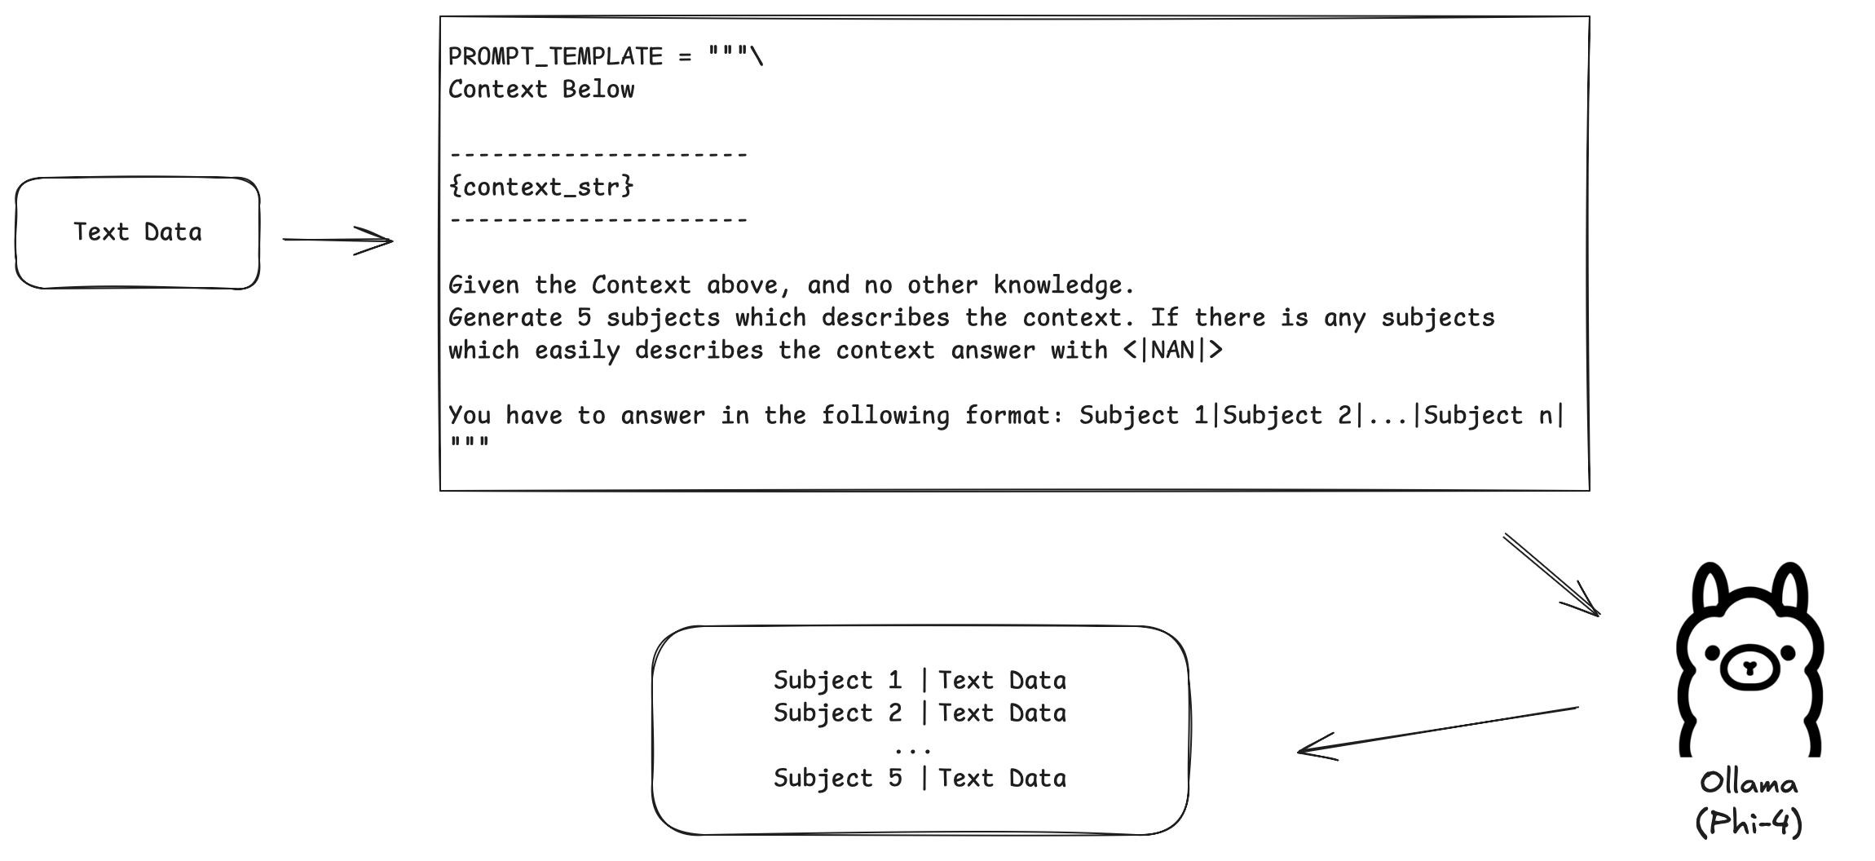
Synthetic Data Generation

Slide 17

Generate Negatives
Synthetic
Unrelated
In Corpus

Slide 18

Batch size
01
02
Higher in batch variability
More passthroughs

Slide 19
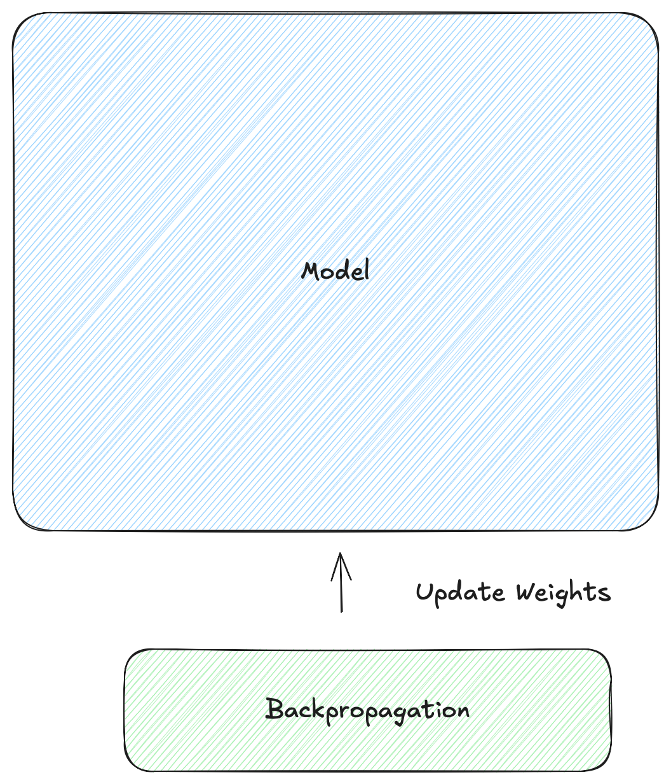
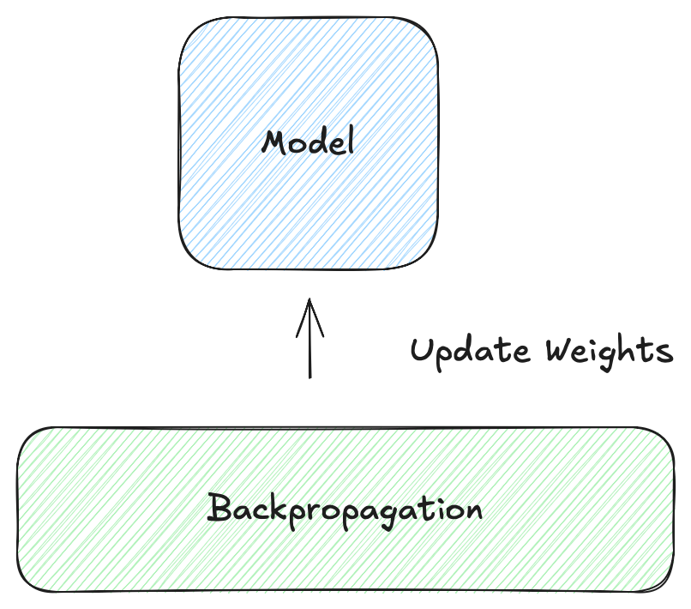

Parameter Efficient Finetuning (PEFT)
Notes:
IA3 = Infused Adapter by Inhibiting and Amplifying Inner Activations

Slide 20
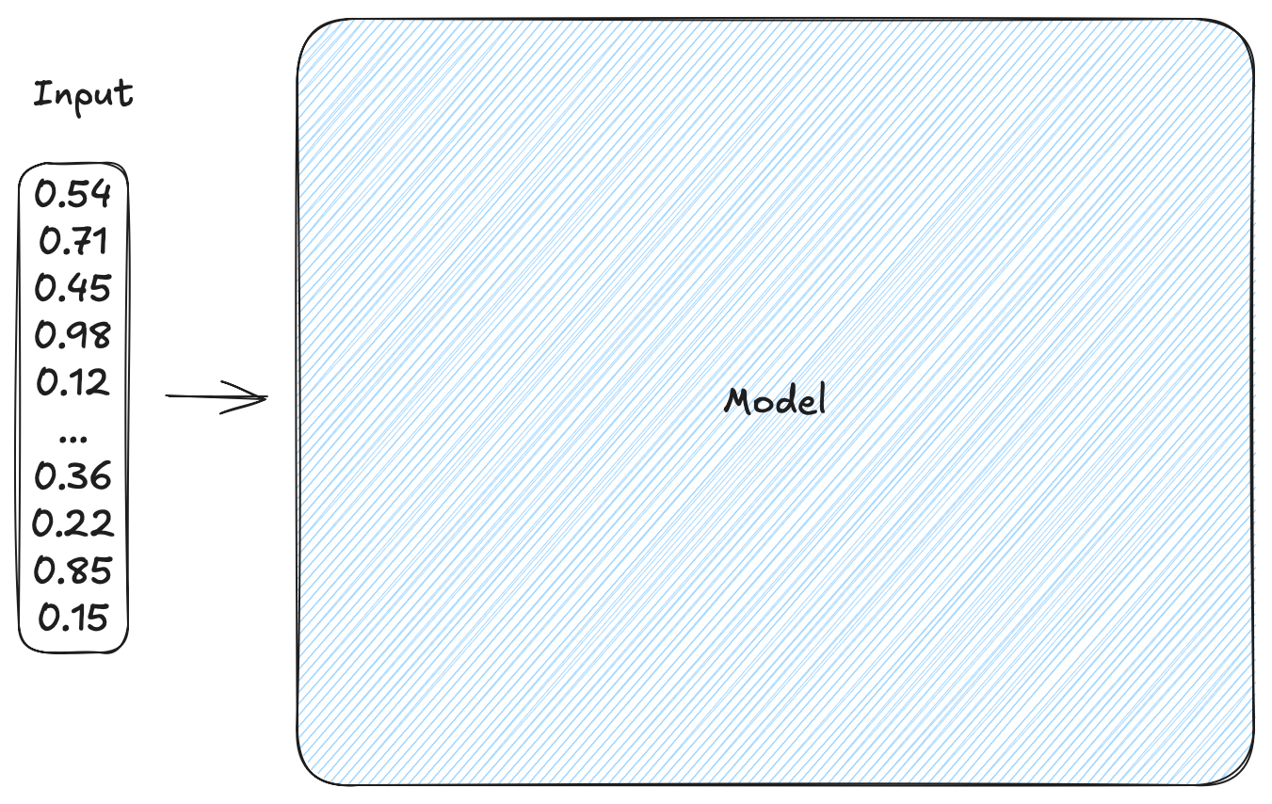
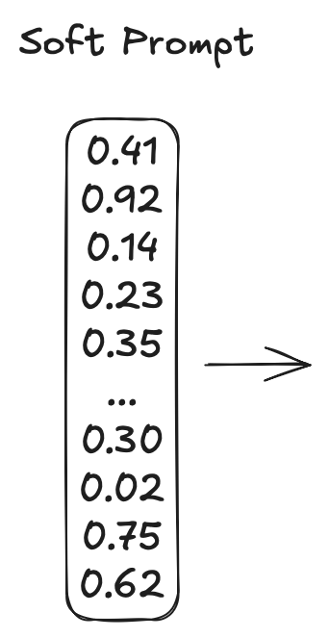
Prompt based methods

Slide 21
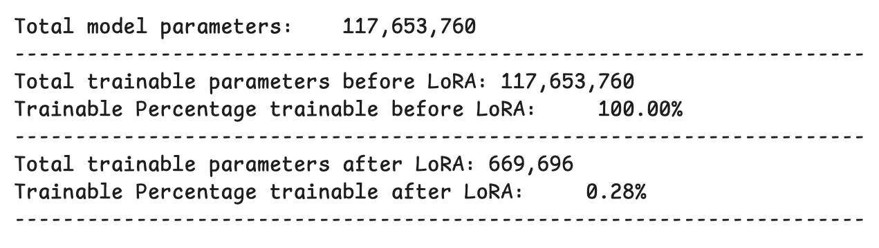
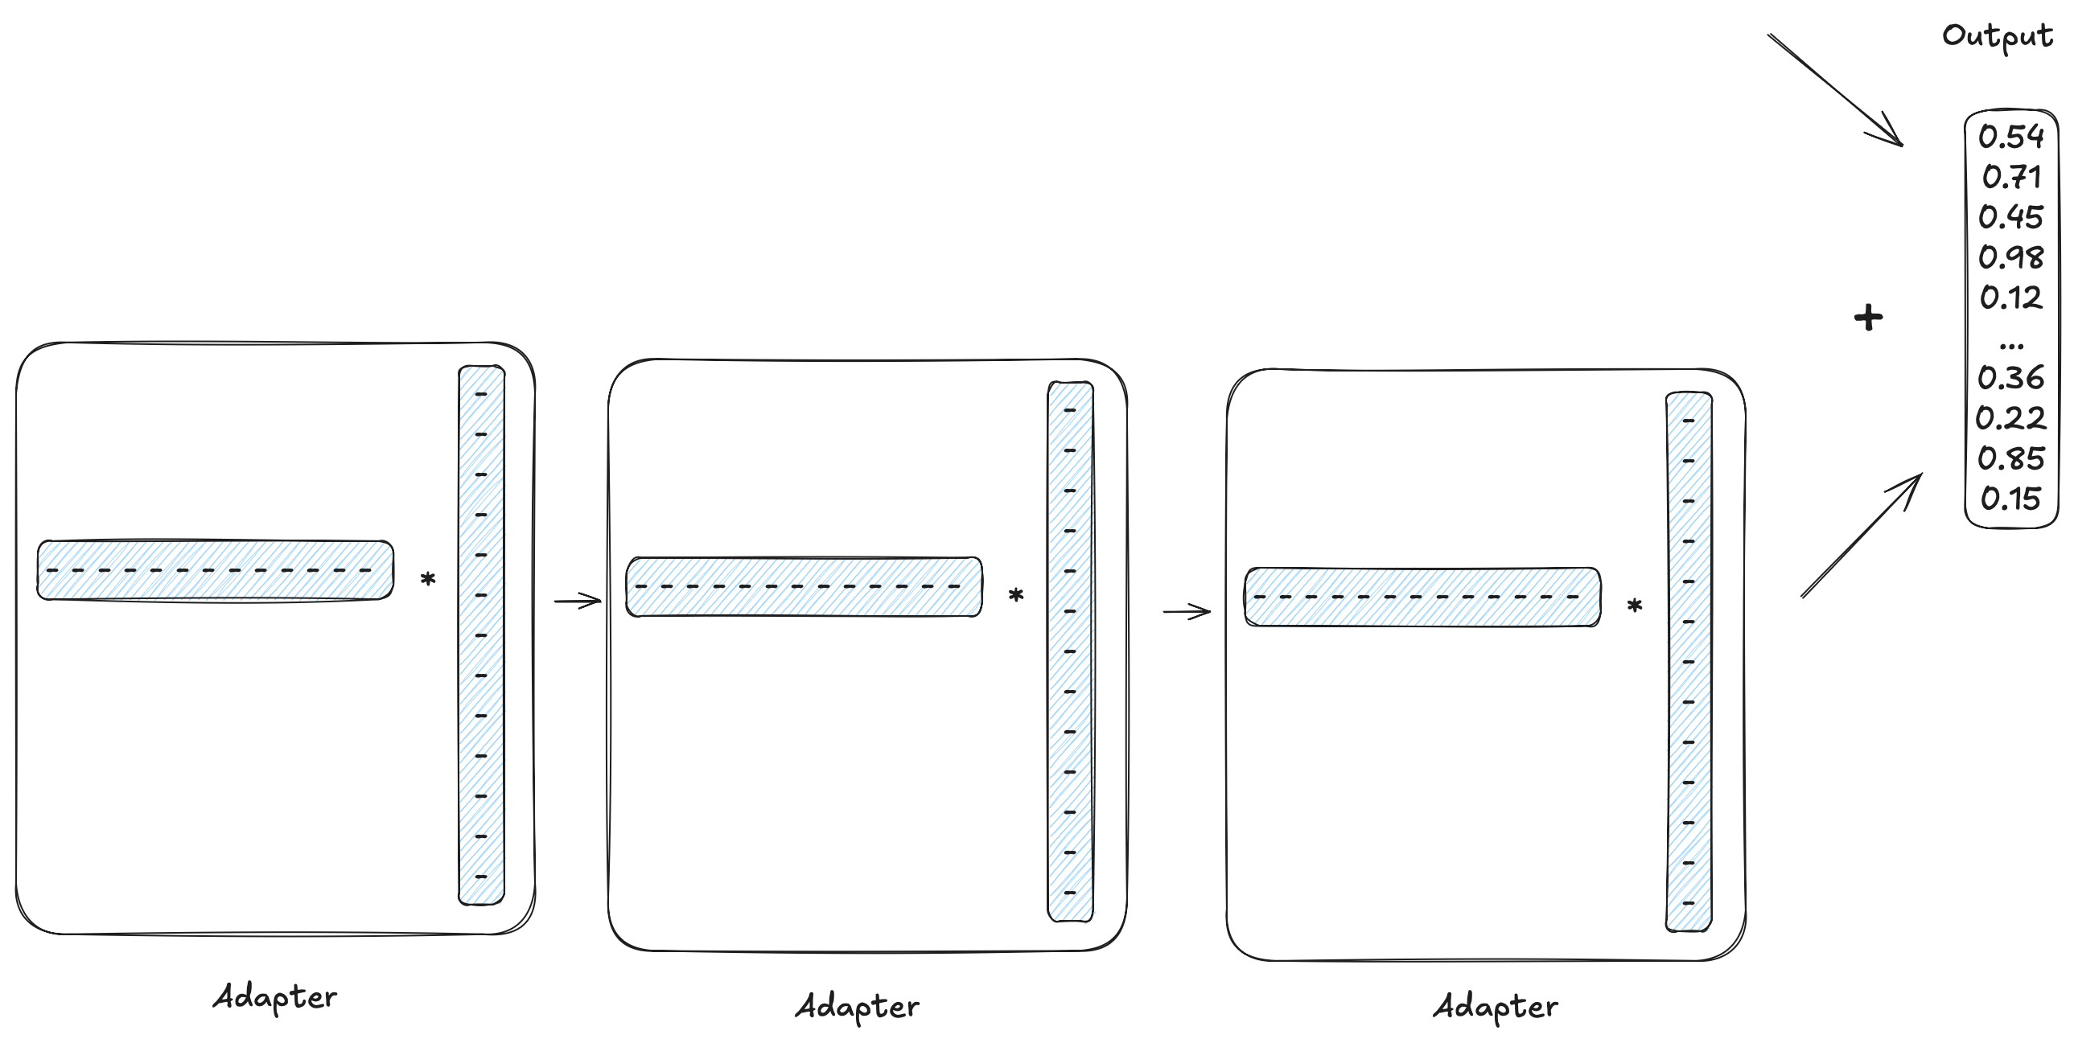
Low Rank Adapter (LoRA)

Slide 22
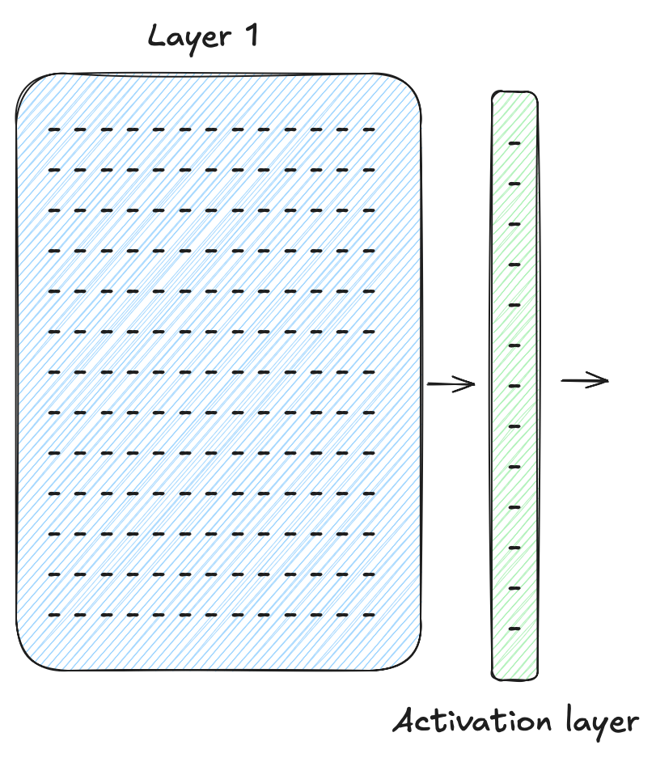
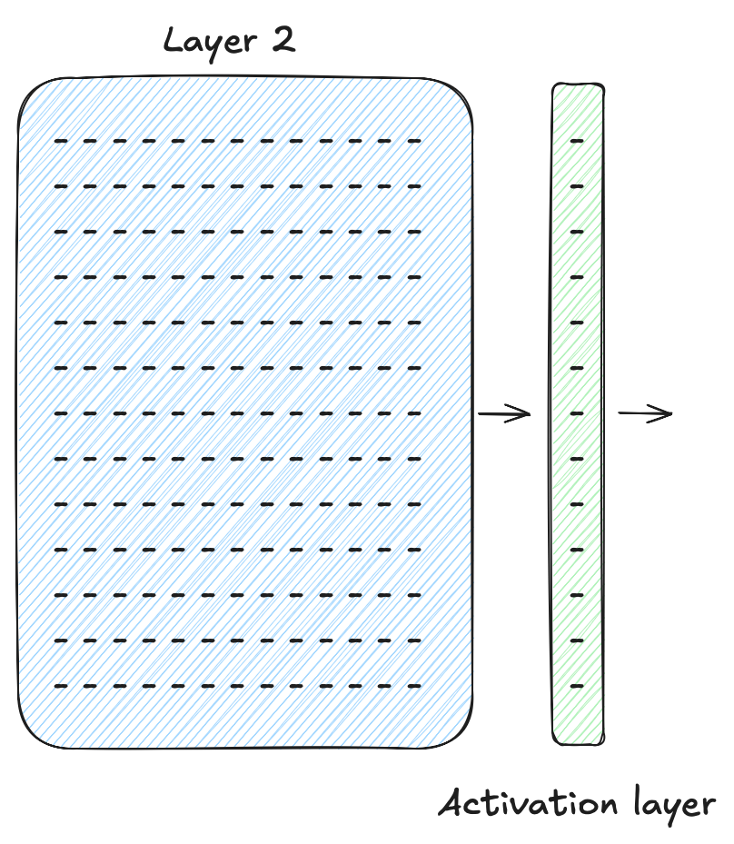
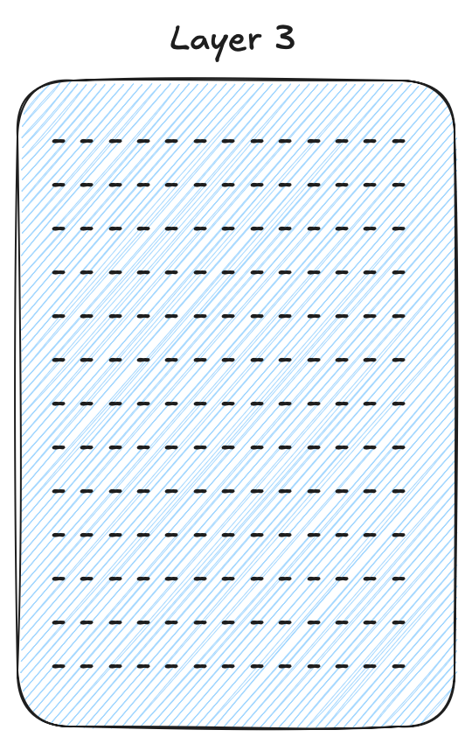
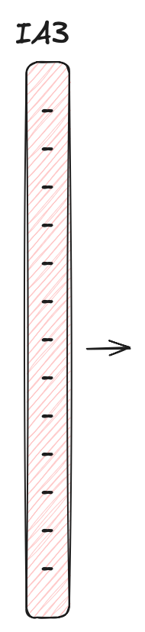
Infused Adapter by Inhibiting and Amplifying Inner Activations (IA3)

Slide 23
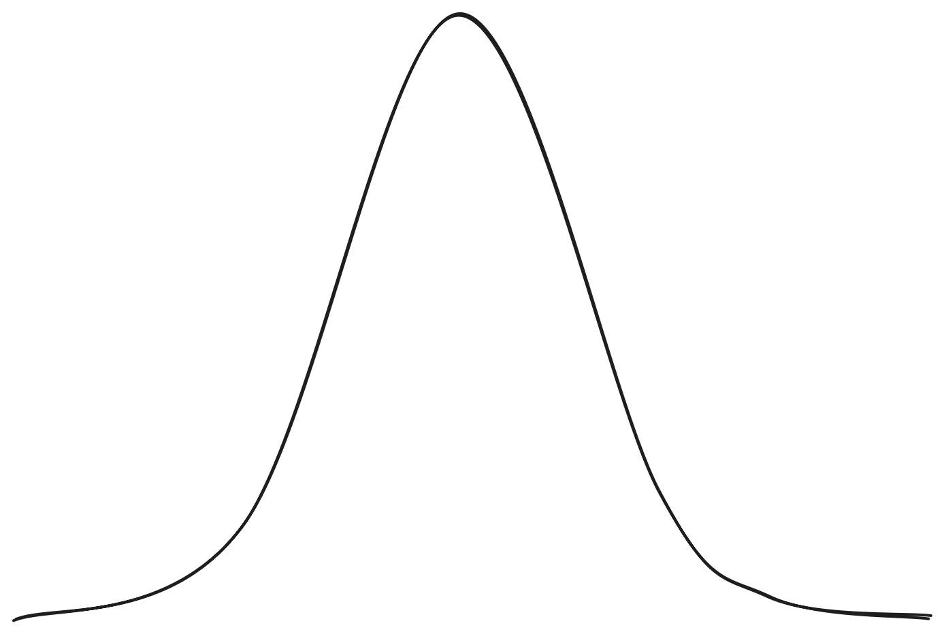
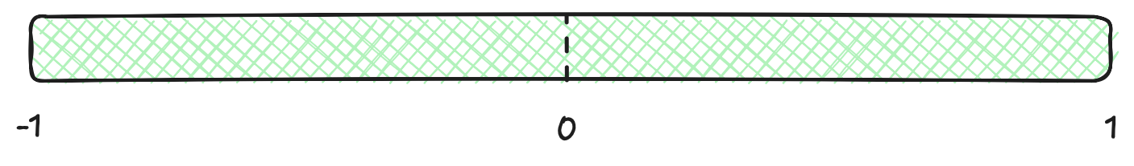


Quantization

Slide 24
04
Tools

Slide 25
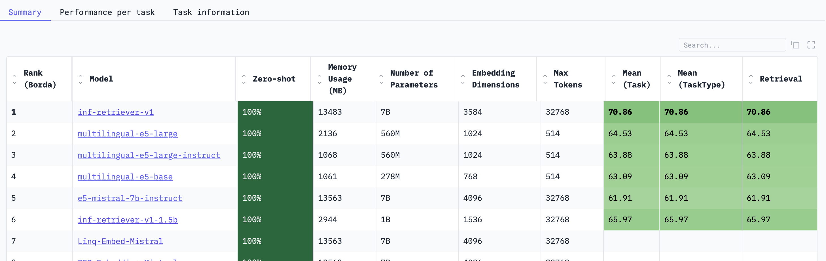
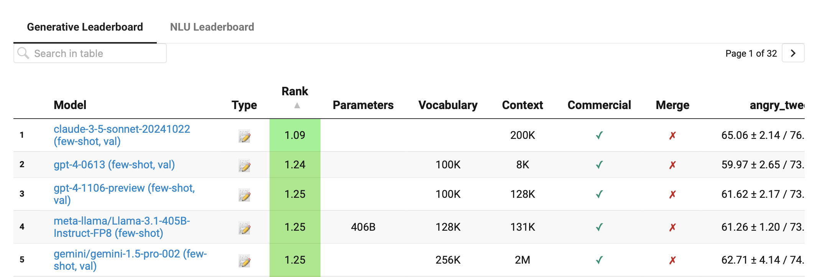
Model Choice
MTEB
EuroEval

Slide 26




Data Storage
+ PG Vector Extentsion

Slide 27
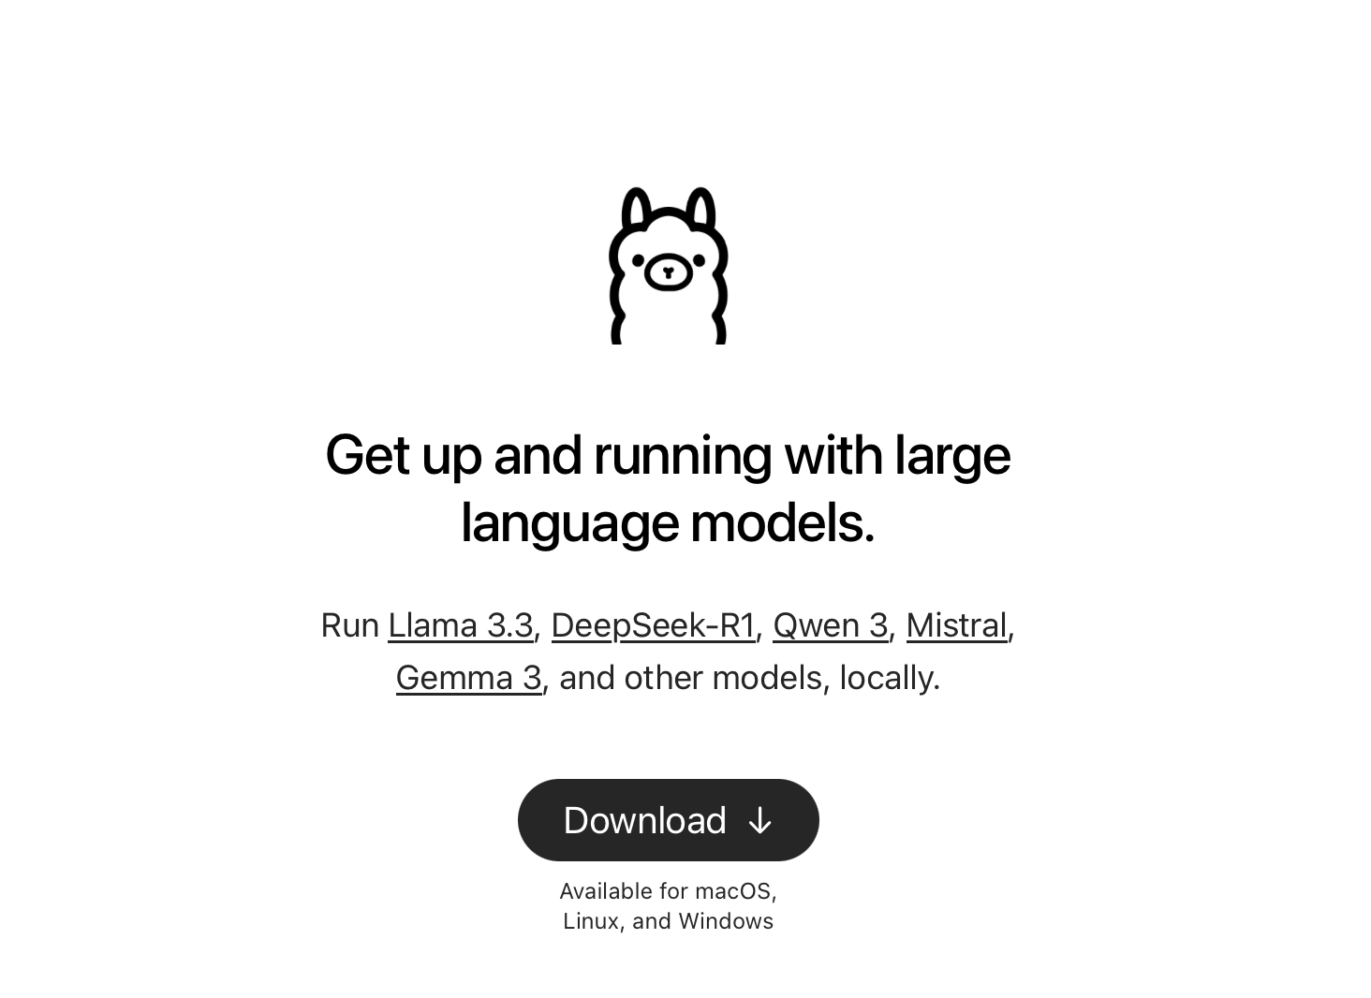
Ollama

Slide 28
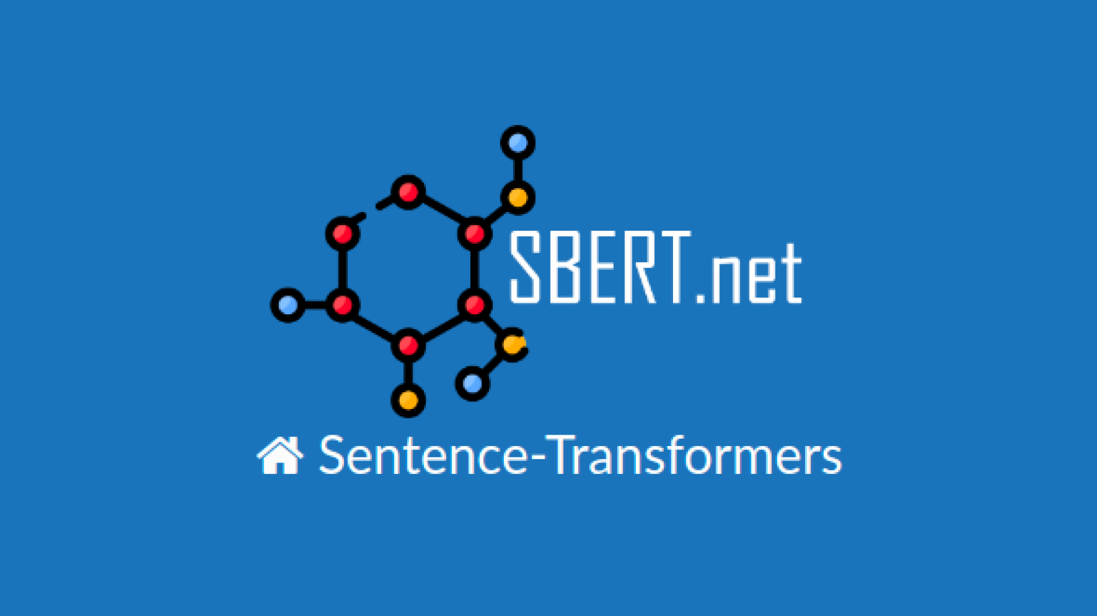
Sentence Transformers Library

Slide 29
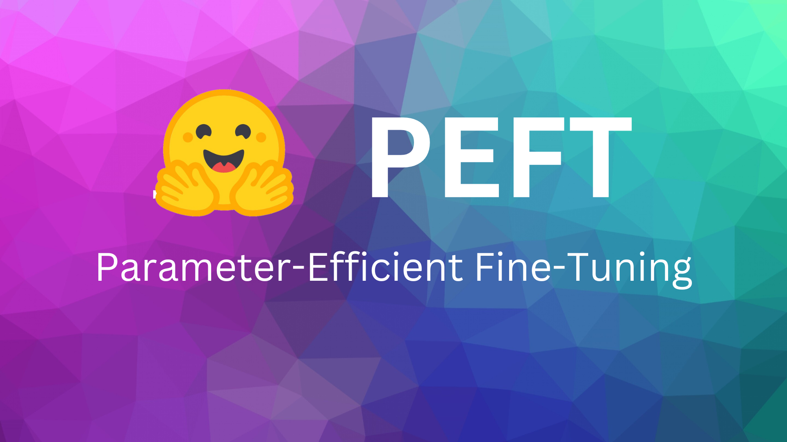
PEFT Library

Slide 30
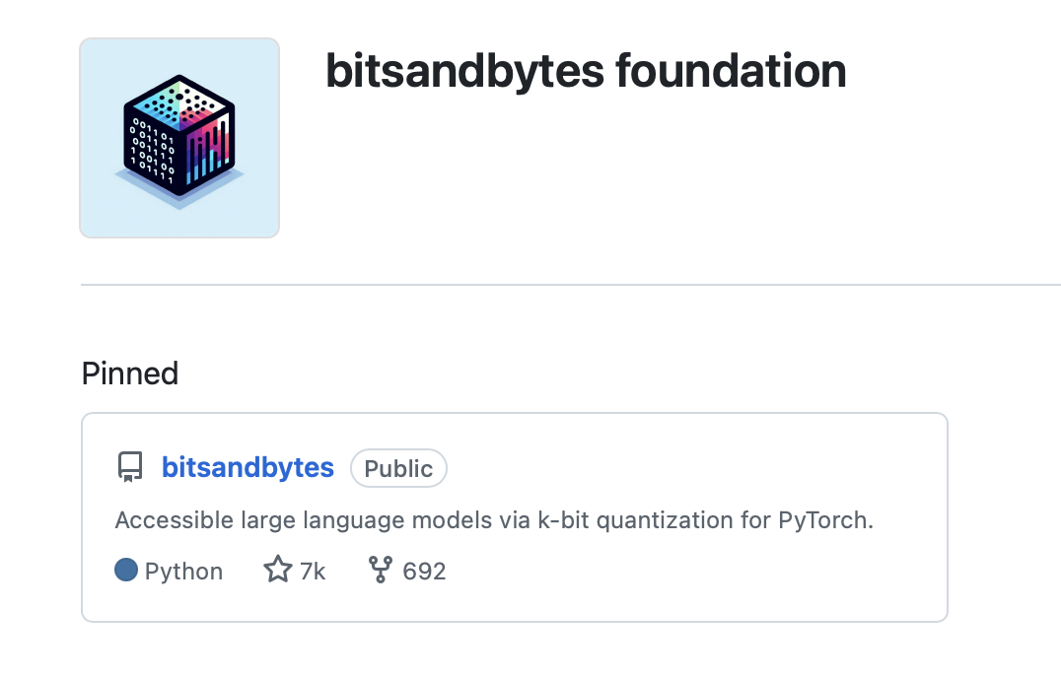
bitsandbytes

Slide 31
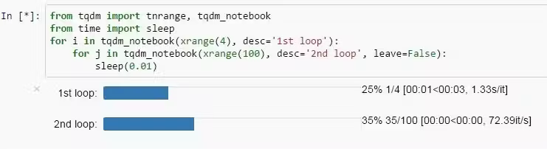
Progress bars (TQDM)

Slide 32
05
Conclusion

Slide 33
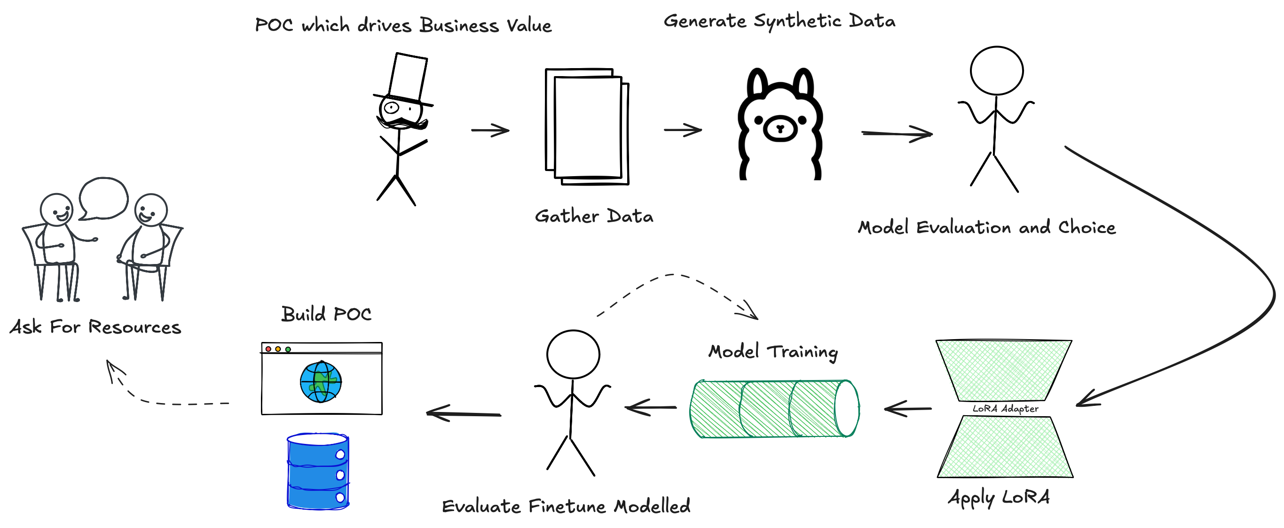
Putting it together

Slide 34

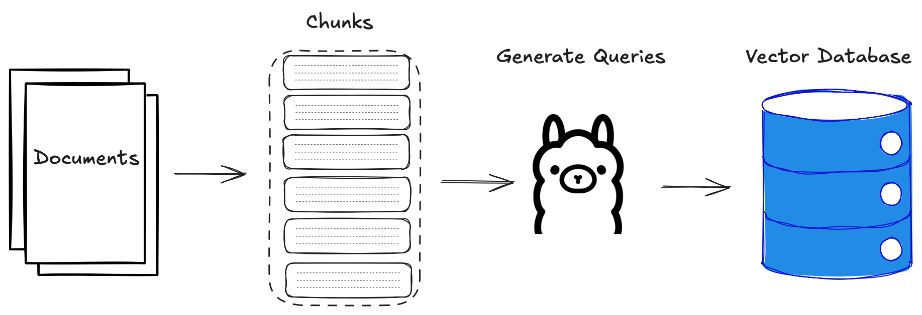
Embed Queries
syv.ai

Slide 35
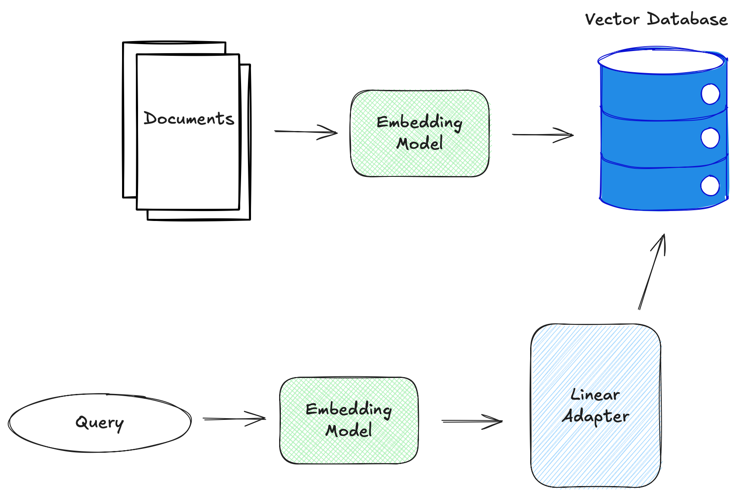
Linear Adapters

Slide 36
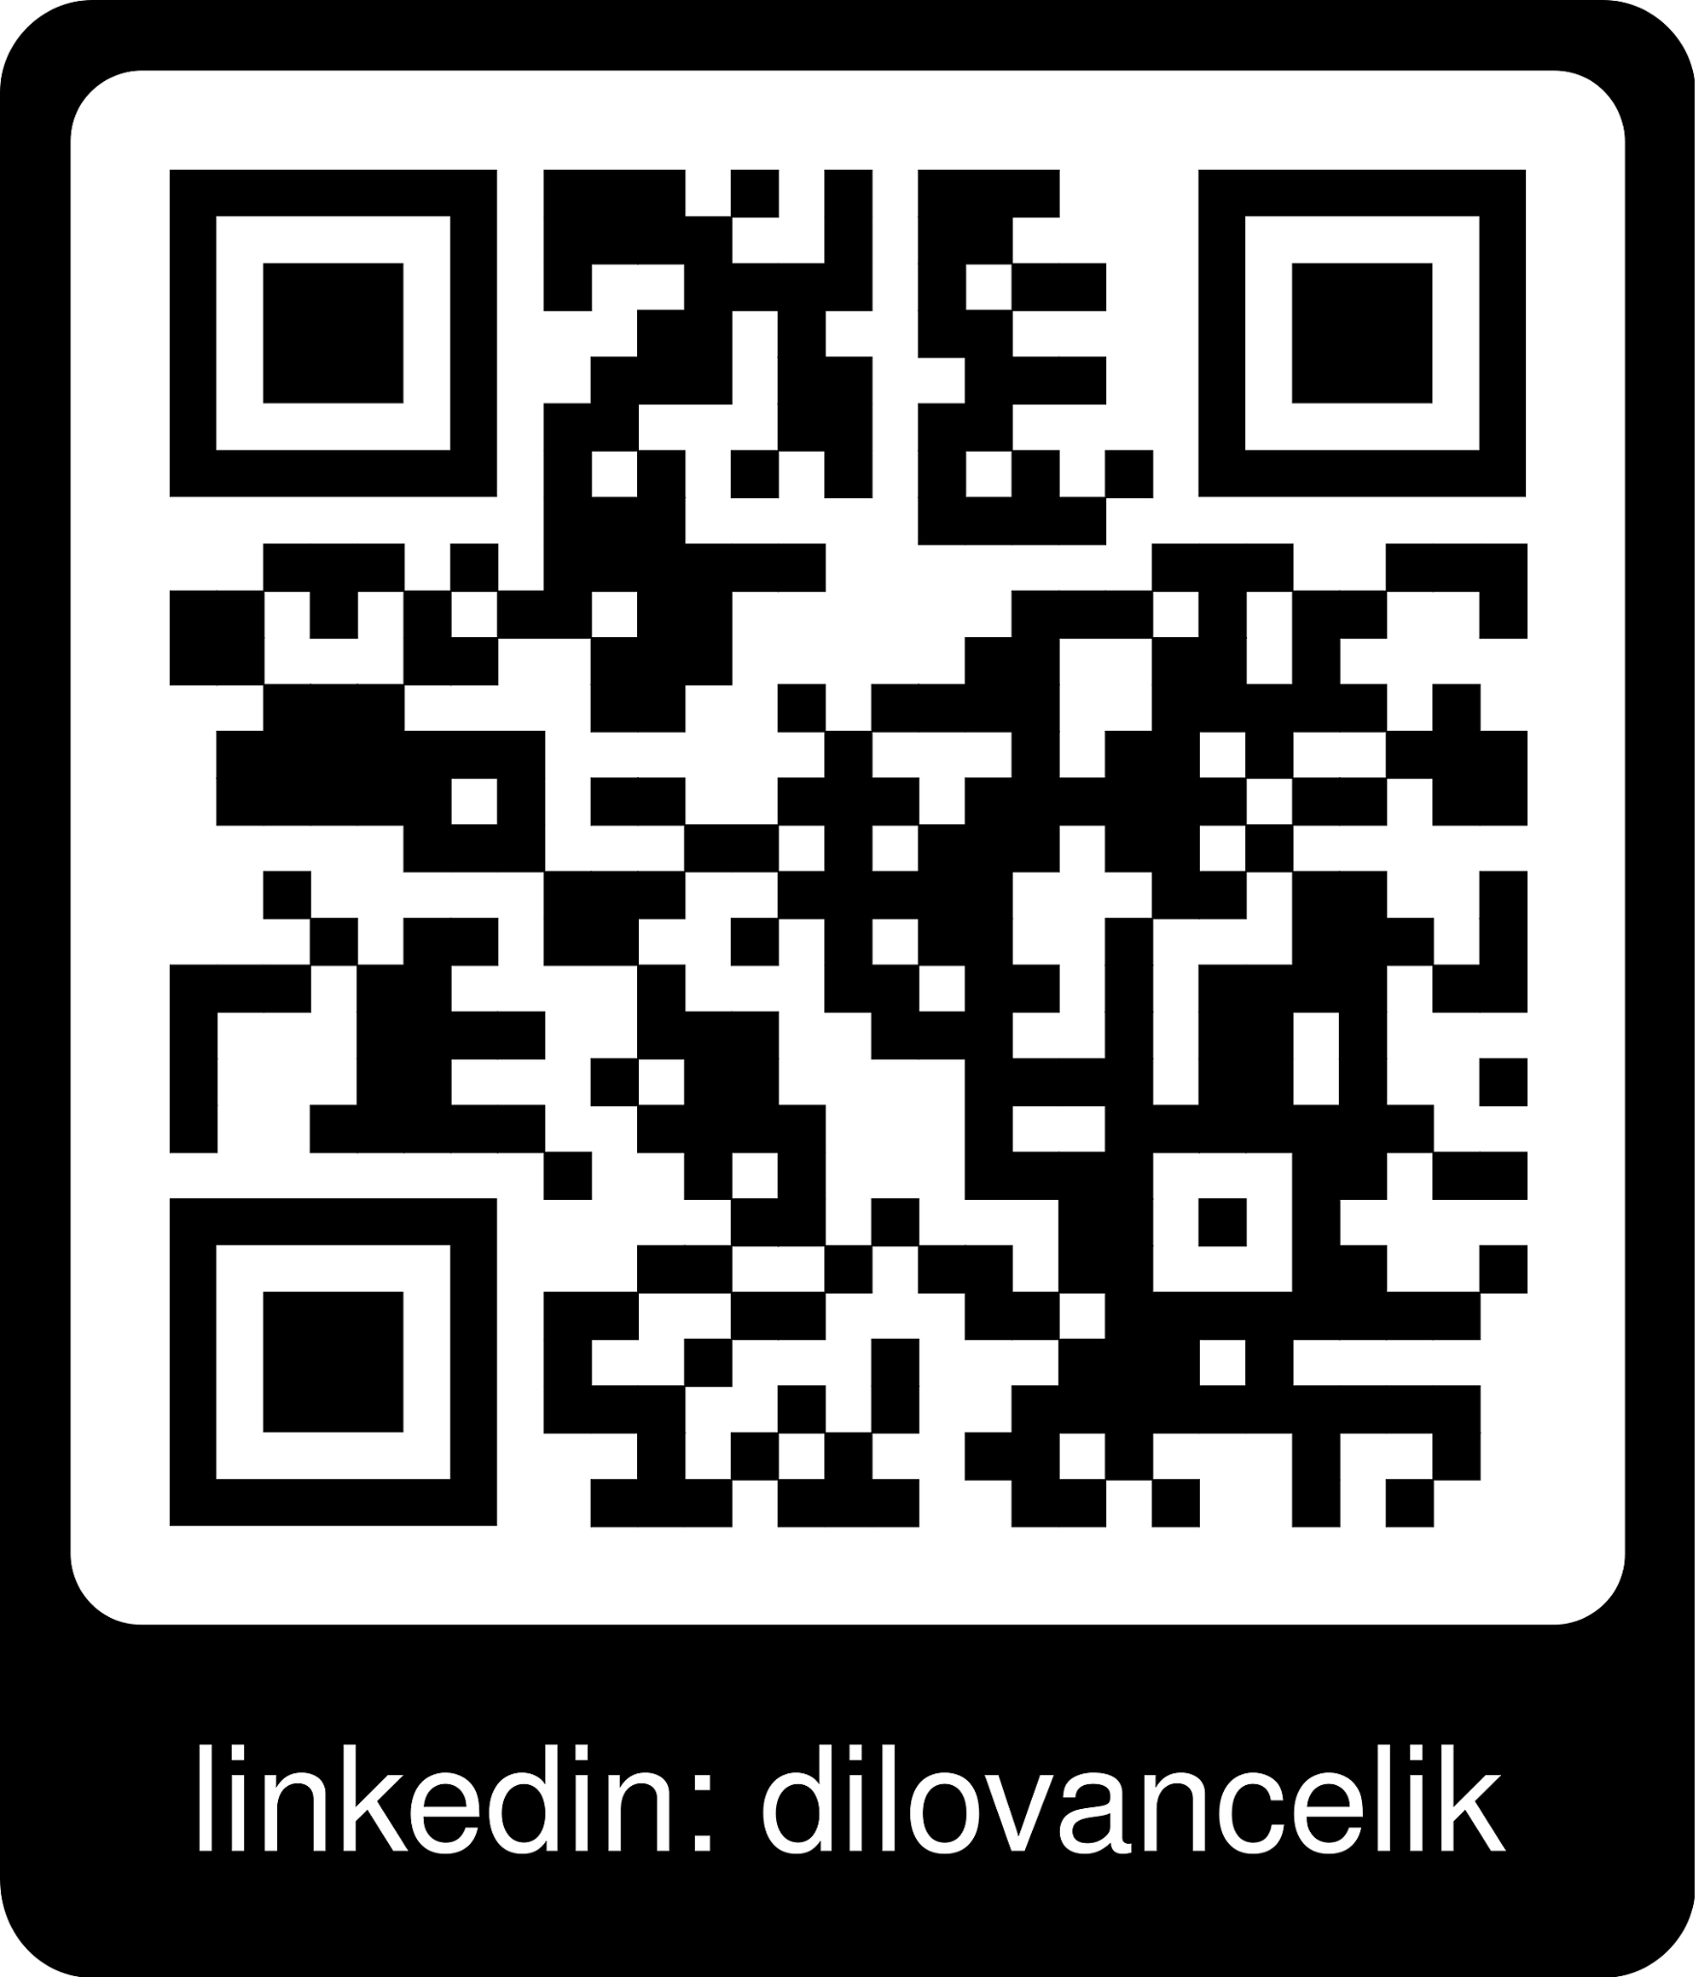
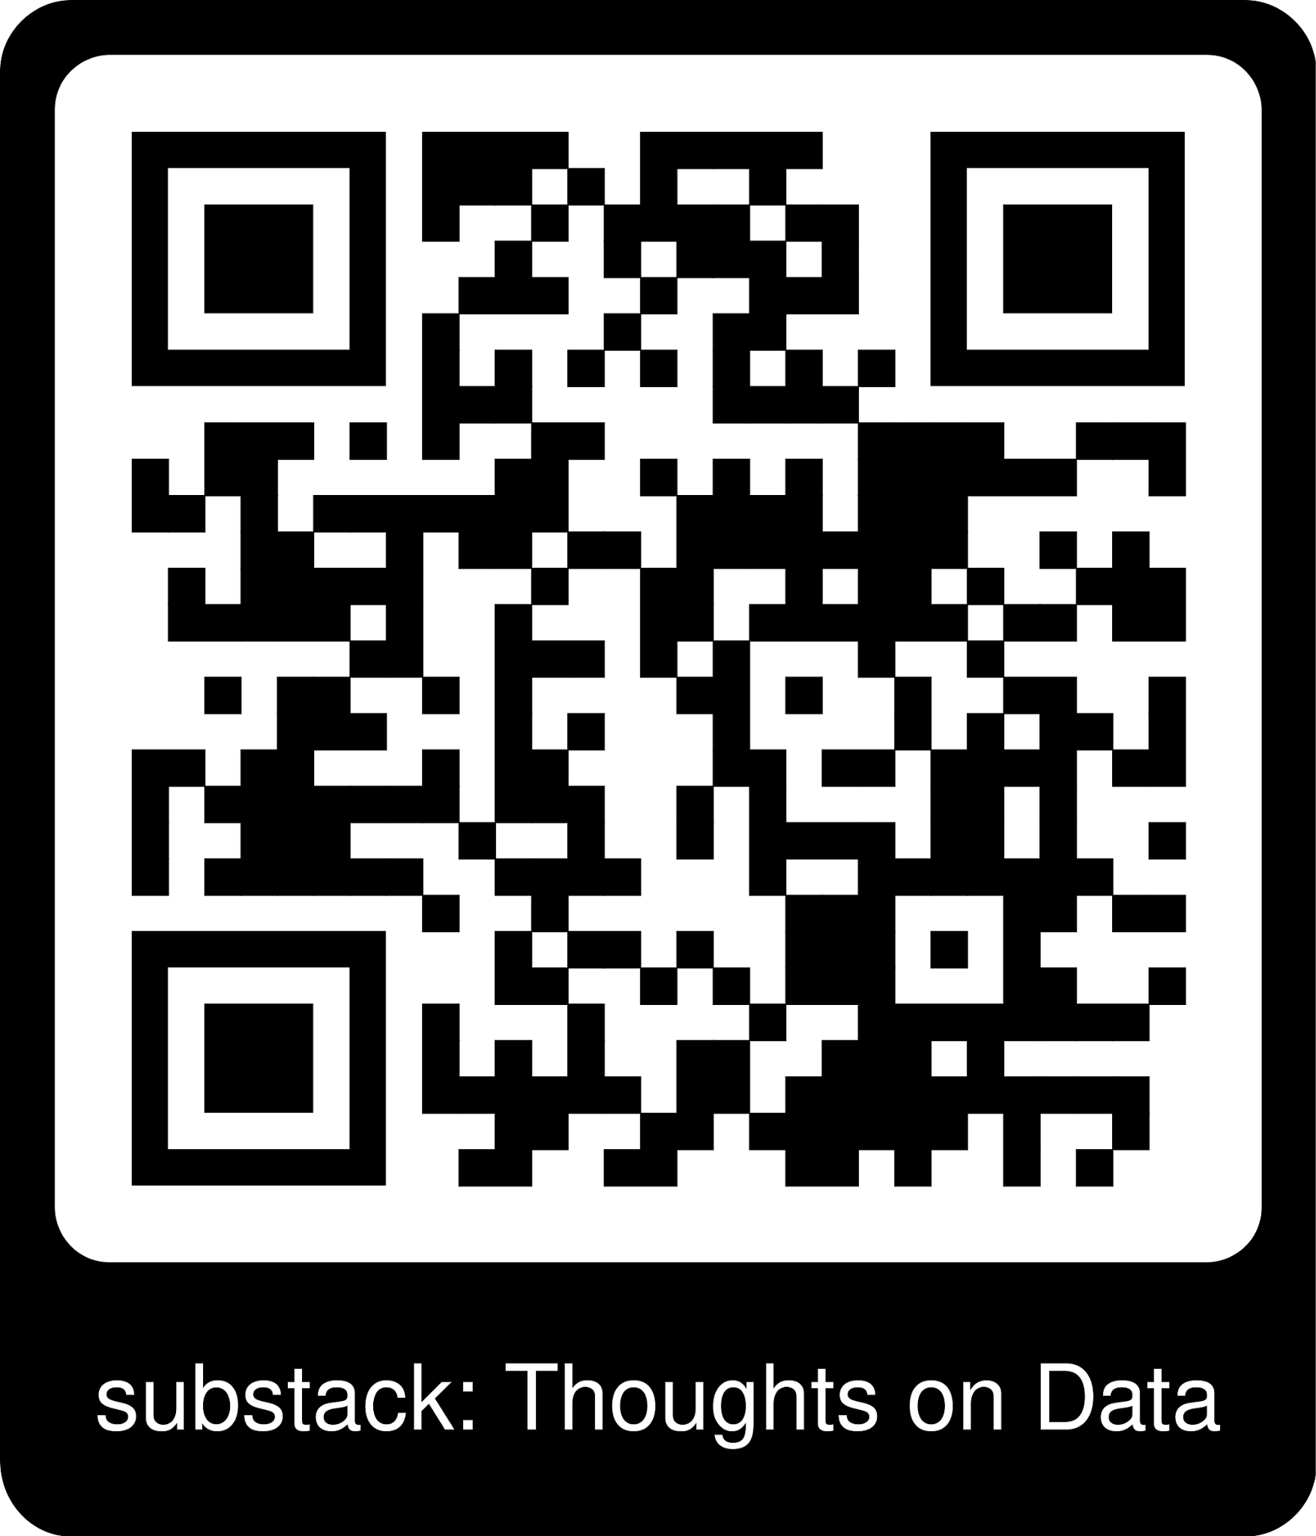
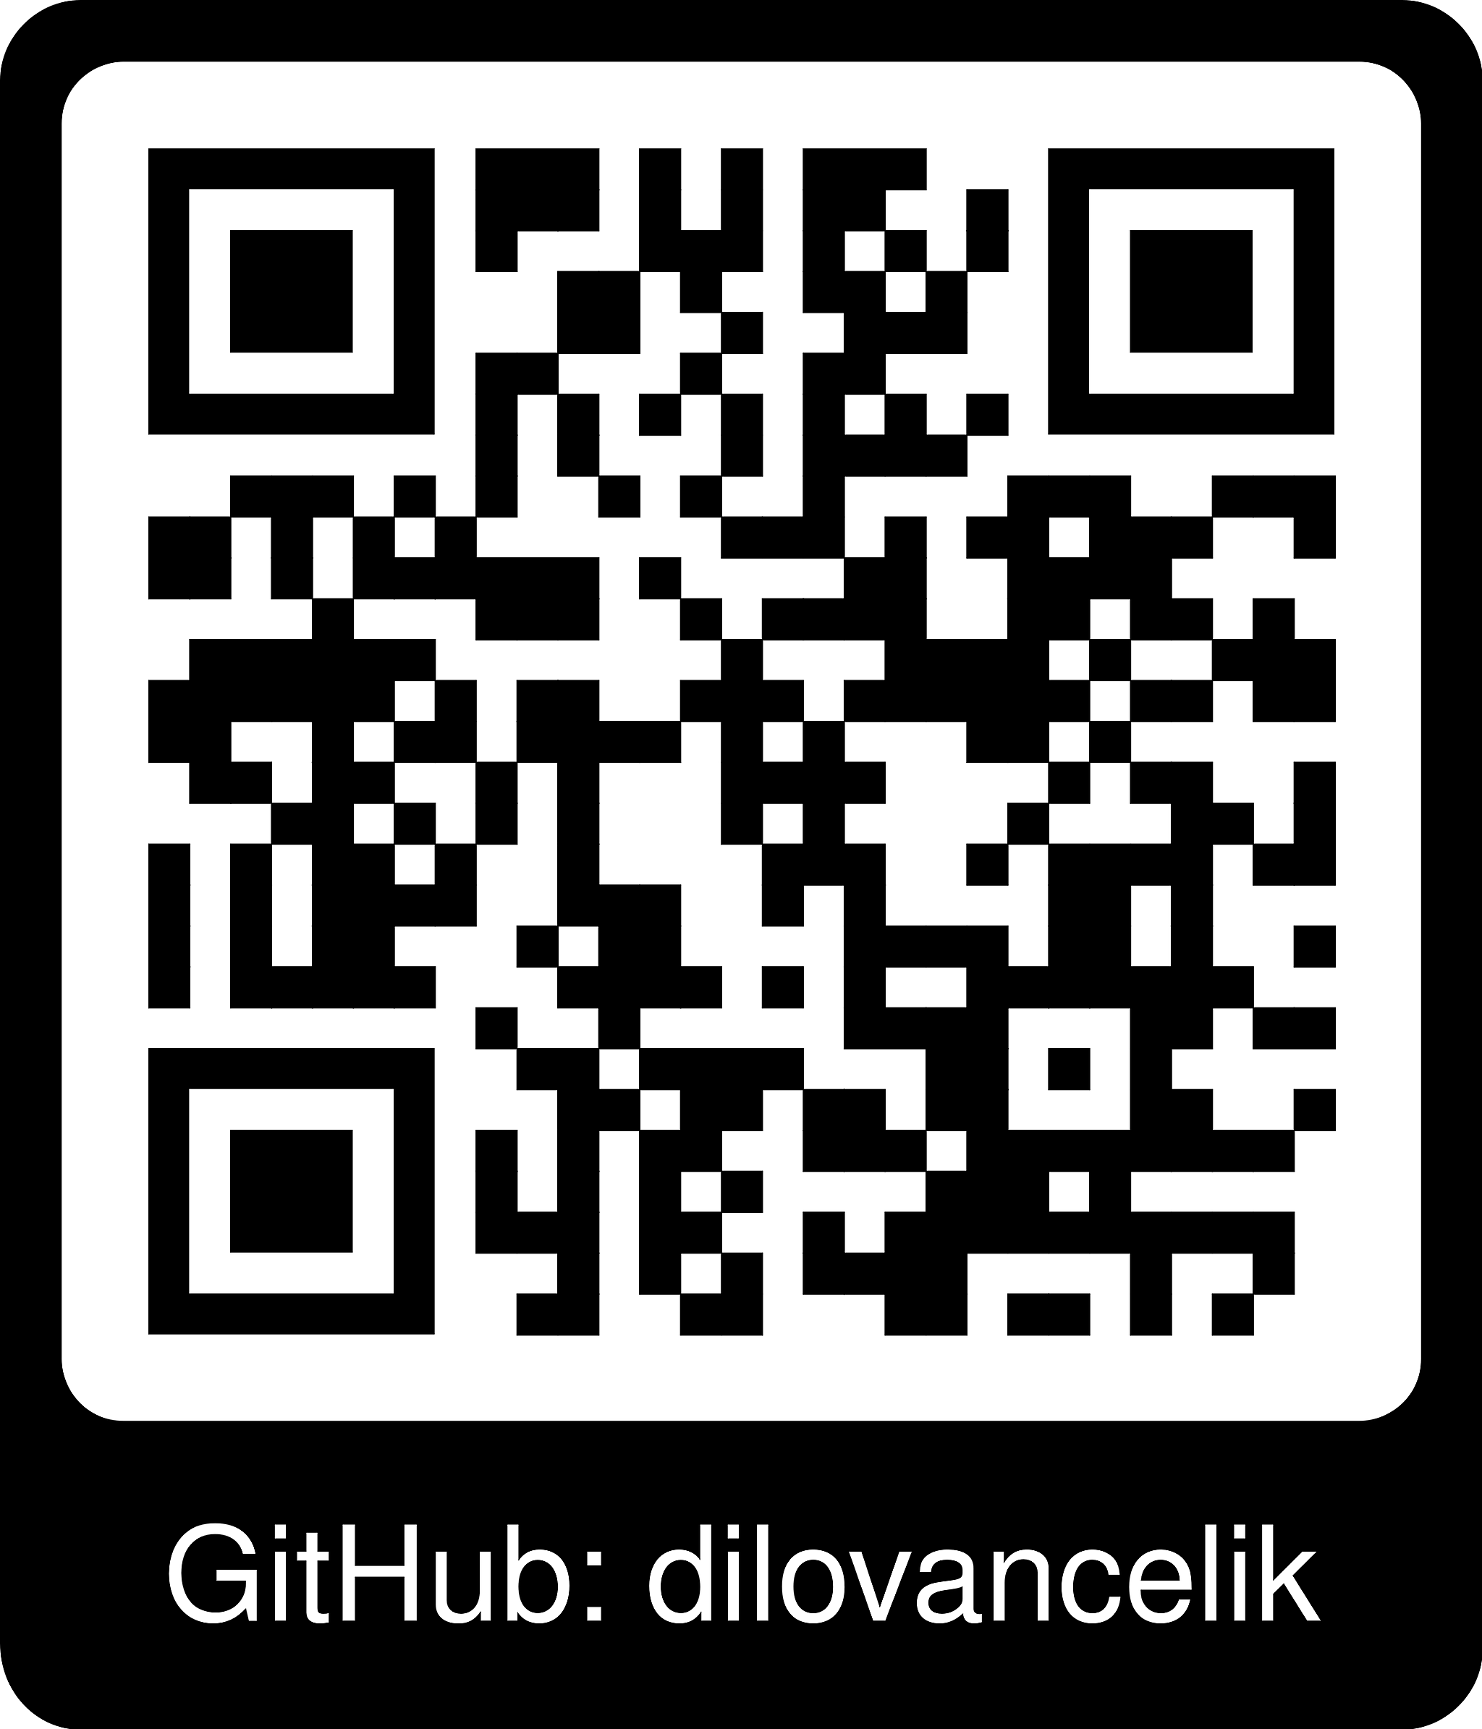
Get Training!

